Slide 1


P-CAST Pharaohs for Courses And Services Technology
React!!
Bootstrap!!
Learn, Practise and Community work All in One.

Slide 2
Table of contents
01
02
03
04
05
Idea
Our Target
Implementation stages
What is the project and what does it include?
Project goals and objectives
Stages of project implementation processes
Timeline
Target group
Project completion dates
People targeted by the project

Slide 3

01
Idea
Community!
What you need to know about the project
Online services!

Slide 4

It is a platform with multiple platforms
Awesome
The platform consists of four platforms (four ideas)
Educational platform
A platform for applying training courses
A platform for communication between educated and uneducated people
A platform for selling electronic services
Apply my learning

Slide 5
Our Target
Improving the level of education
Raising the level of learners
Provide job opportunities
Some people suffer from difficulty learning new skills due to the many problems they face, and P-CAST has made this easy for learners
There are many people who are not aware of the importance of programming, so we spread awareness of the desire to learn these things.
There are many newly educated experts who cannot find a job, so we decided to give them opportunities to get one. On the other hand, we decided to facilitate electronic services for those in need.

Slide 6

Online Community
Assist
Sometimes we find it difficult to learn something, so we provide the opportunity for learners to communicate to benefit each other.
Easy Communication

Slide 7
28/12/2024
28/1/2024
15/02/2024
The deadline for completing the front-end design
Ranking
Assignment
Date of completion of the back-end design
Creativity!
Final publication date for users

Slide 8
Implementation stages
25%
50%
75%
User interface design
Database design
Create a trial version
All pages on which users control and perform their functions
All important data about our users and site data
Find out users' opinions about this version and correct the problems

Slide 9
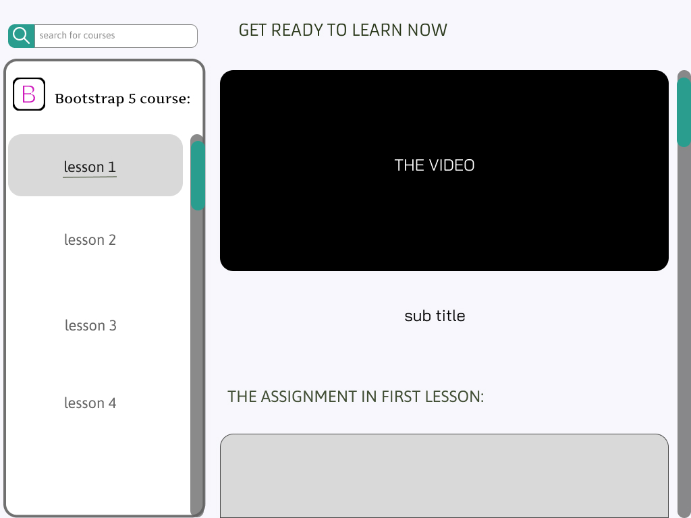
Online courses
The most important feature of this website is the course platform that allows you to listen to the video at any time and in any place with ease of use in dealing with it.

Slide 10
Target group
Everyone has experience that they can offer to someone
Everyone wants to learn a new skill
Provider
services
Learners
01
03
02
Wanted services
Everything that needs a service can be solved by someone

Slide 11
Project users
18%
16%
Teenagers
Elderly people
22%
23%
Adults
Youth
Under 18 years old
Who are over 60 years old
Between 20and 30years old
21%
Between 30 and 40 years old
The middle age
Between 40to 60years old

Slide 12

Our team
Abram Mina
Team leader and responsible for courses
Veronica Shnoda
Omar Khaled
Front and back-end designer
Developers
Presentation designer and backend designer
Menna
Youssef Hani
Front and back-end designer
Graphics and front-end designer

Slide 13


